Slide 1
HEART DISEASE PREDICTION
TSP- AI ML Fundamentals (Capstone Project)
Presented By:
Student Name : DIVINA H
NM ID: A8BF2E9BCADCA22BC4B4025B15F33CC5
College Name: ANNA UNIVERSITY REGIONAL CAMPUS - TIRUNELVELI
Guided By:
RAMAR BOSE
Sr. AI Master Trainer

Slide 2
OUTLINE:
Problem Statement
Proposed Work
Algorithm
GitHub Link (for code)
Project Demo(photos / videos)
Conclusion
Future Scope
References

Slide 3
Problem Statement
Modern information technology tools and techniques such as AI, machine learning and data mining could help support healthcare professionals by providing them with the information they need to make decisions that will minimize deaths caused by heart disease at minimal cost.
For example, machine learning algorithms can mine large databases to identify frequent patterns that eventually lead to heart disease and death.

Slide 4
Proposed Work
The collection of data and selection of the most crucial attributes is the first step in the system's operation.
The relevant data is then preprocessed into the format needed.
After that, the data is split into training and testing data.
The algorithms are used, and the training data is used to train the model.
By testing the system with test data, the correctness of the system is determined.

Slide 5
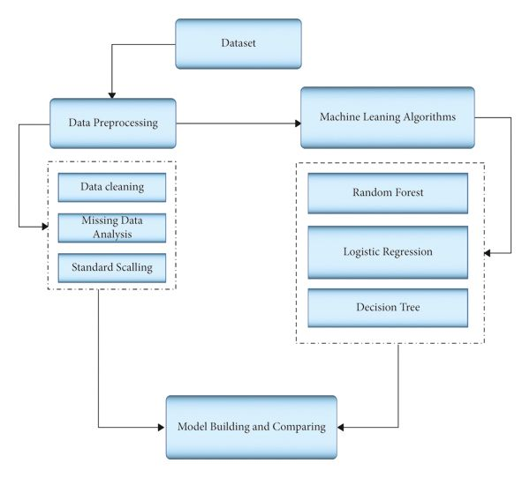
Algorithm
The modules listed below are used to implement this system.
1. Collection of Dataset
2. Selection of attributes
3. Data Pre-Processing
4. Balancing of Data
5. Disease Prediction

Slide 6
GitHub Link
https://github.com/DIVINA-012/NM-project---Heart-Disease-Prediction
Google Colab Link: https://colab.research.google.com/drive/1ZRX_SUI5q8sqpIHojMuOe2KQqy329CWr#scrollTo=cixSdmC8mglD

Slide 7
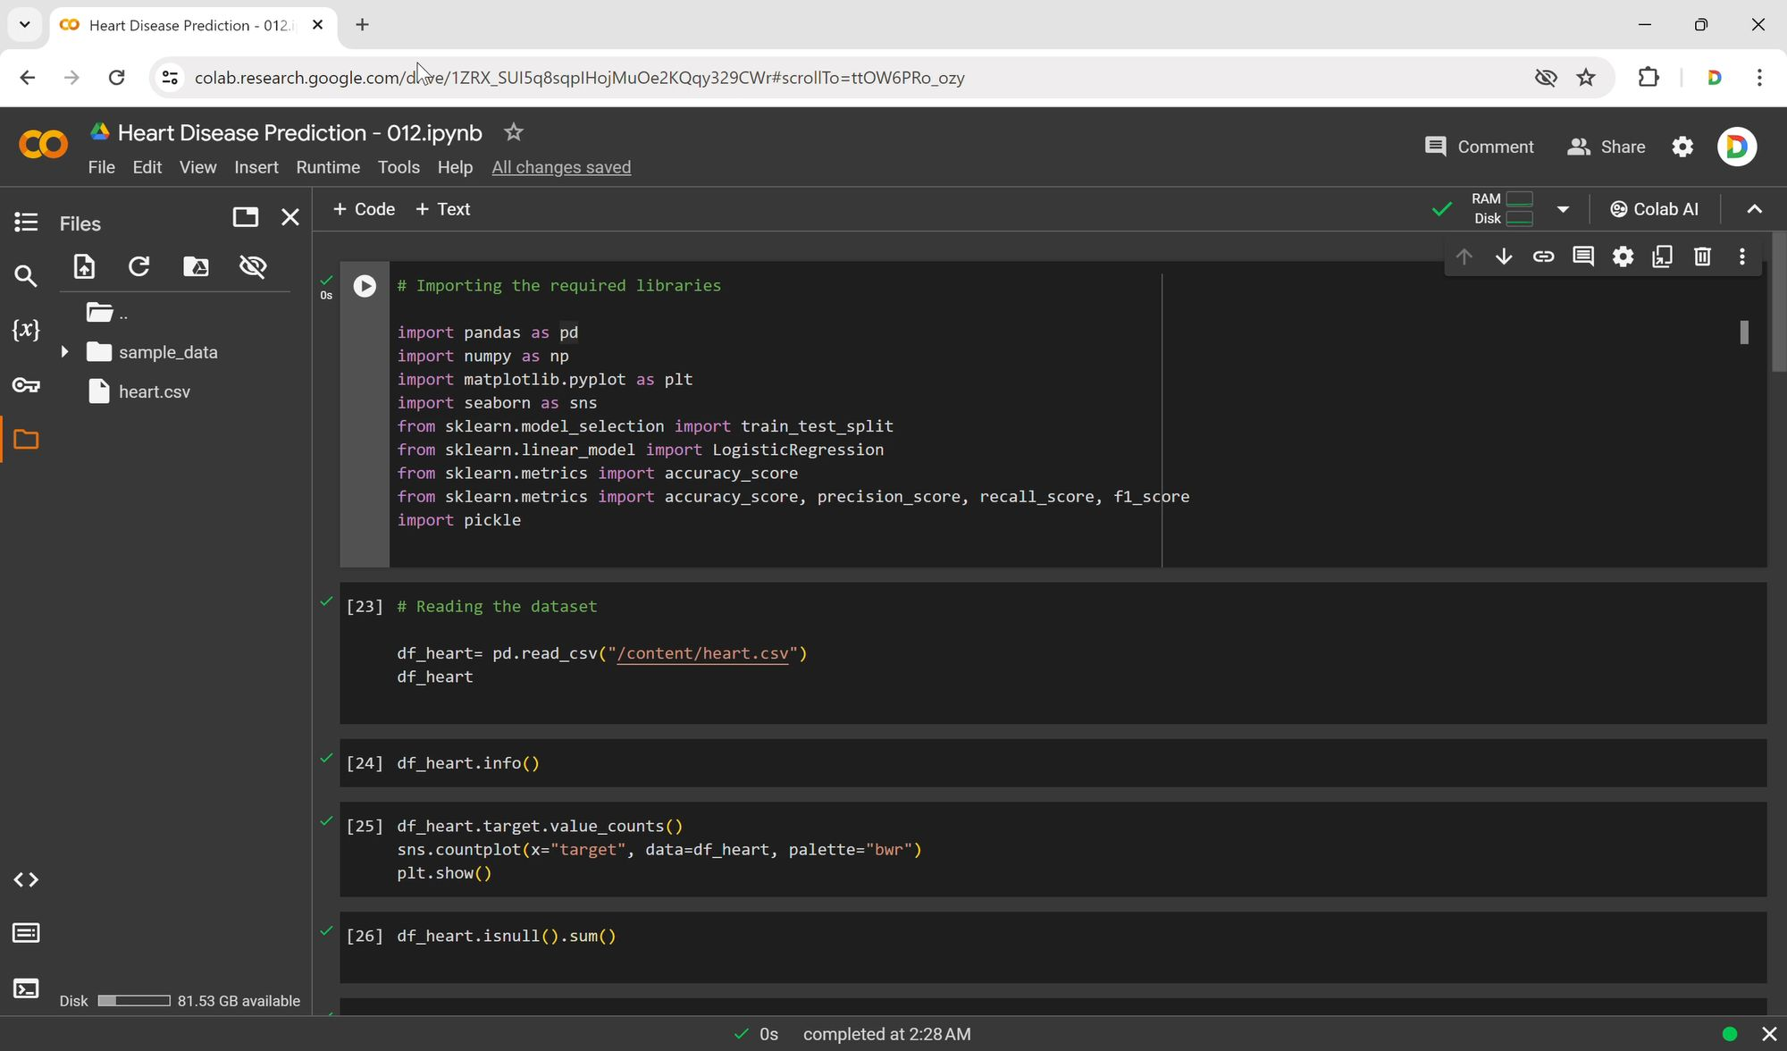
Project Demo(Recorded Video)

Slide 8
Conclusion
Logistic Regression returned the accuracy score of 84.94% when the maximum number of features selected.
K-Neighbors Classifier returned with the highest accuracy score of 91.95%, which was achieved when the number of neighbors was selected.
Random Forest Classifier returned with the highest accuracy score of 100% when a forest with the size of 3200 decision trees was selected.
Therefore, it can be concluded that Random Forest Classifier performed best amongst all three classifiers.

Slide 9
Future Scope
In this project we made a which gives us the best accuracy among all the machine learning algorithms and by using that model we have made a web service using streamlit which will connect the back end of machine learning model to the front end that we designed it, with of help of this many people can get their health condition priorly and 50-43might taken care accordingly .
We have tried it on our local host. We are going to implement by adding some features to our deployed model like adding all algorithms and by showing the ROC curve to the people who are using it to predict and make some changes and then we can implement it as an online website.

Slide 10
References
"Logistic Regression". En.Wikipedia.Org, 2020, https://en.wikipedia.org/wiki/Logistic_regression.
" Random Forest". Medium, 2020, https://towardsdatascience.com/understanding-random-forest-58381e0602d2.
https://www.geeksforgeeks.org/ml-heart-disease-prediction-using-logistic-regression/
M. I. K. ,. A. I. ,. S. Musfiq Ali, "Heart Disease Prediction Using Machine Learning Algorithms".
M. A. K. S. H. K. M. a. V. P. M Marimuthu, "A Review on Heart Disease Prediction using Machine Learning and Data Analytics Approach"

Slide 11
THANK YOU

